Slide 1


Protein Correlation Tool
Kevin Yang
Fall 2022
Faculty Mentor: Dr. Samir Abdelrahman
Industry Mentor: Jake Carter
Notes:
overview:
About Biolexis and team
FIELDS platform and where this tool fits in
Skills & Knowledge acquired to create this tool that I didn’t learn in class
Data Architecture
System Design
Wrap up/conclusions
Demo

Slide 2
About Biolexis Therapeutics
(Pre)clinical-stage biopharmaceutical company
Small-molecule therapeutics
3 Drug pipelines
Notes:
Founded in August 2021
Library that is targeting a diverse portfolio of disease modifying proteins
Fields is a protein hotspot screening technology to identify and design new medicines

Slide 3

Meet the Team
Jake Carter
Director of Data, ML, and Technology
Project Mentor
Contribution:
Product planning and design
Showcased useful tools in data
End-to-end support

Slide 4

Meet the Team
Cameron Zabriskie
Senior Data/Machine Learning Engineer
Contribution:
System and application architecture
AWS
Anyscale
Git
Showcased useful tools in data
Ray
Binding pocket correlation data

Slide 5

Meet the Team
Nicholas Jensen
Software Engineer
Contributed:
System and application architecture
Streamlit
Internal API/AWS REDSHIFT

Slide 6

Meet the Team
Evan Marshman
Data/Machine Learning engineer
Contributed
Showcased useful tools in data
Polars
Hashing packages/tools

Slide 7
Background
FIELDS™ platform contains library of small molecules with known performance in a set of protein targets.
Use real-world-data in the FIELDS™ platform and various computational techniques to find hits.
This tool is intended to give our scientists a jump start in finding molecules with the highest outcome of success.
Notes:
First company to combine a wet lab database with an AI/ML discovery platform
Accelerate development of clinical candidates

Slide 8
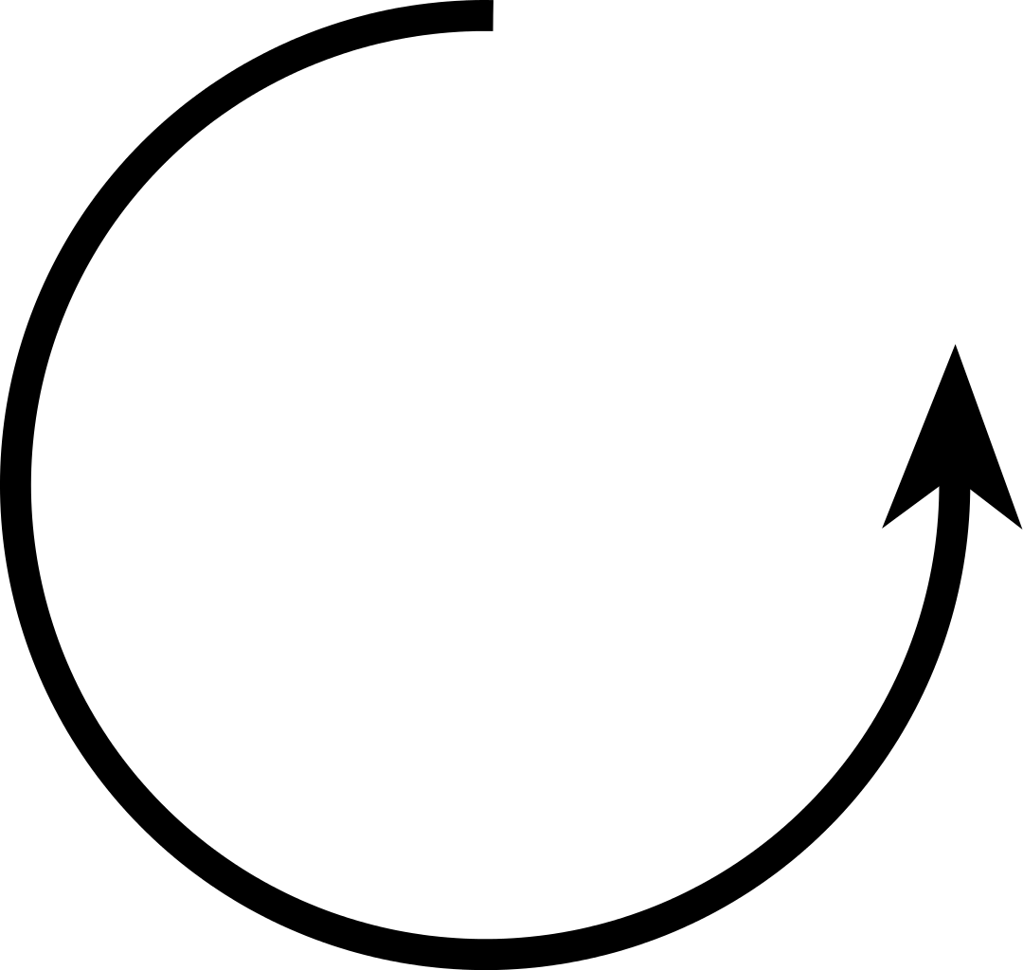
FIELDSTM Workflow
Internal/Partner
Receives compounds
Determines target
Optimizes for
specific characteristics
Review FIELDSTM fragment library
FIELDSTM
Human in Loop
Grounded in Reality Loop
AI / ML
Selects candidates based on criteria
Identify fragments with same/similar binding

Slide 9
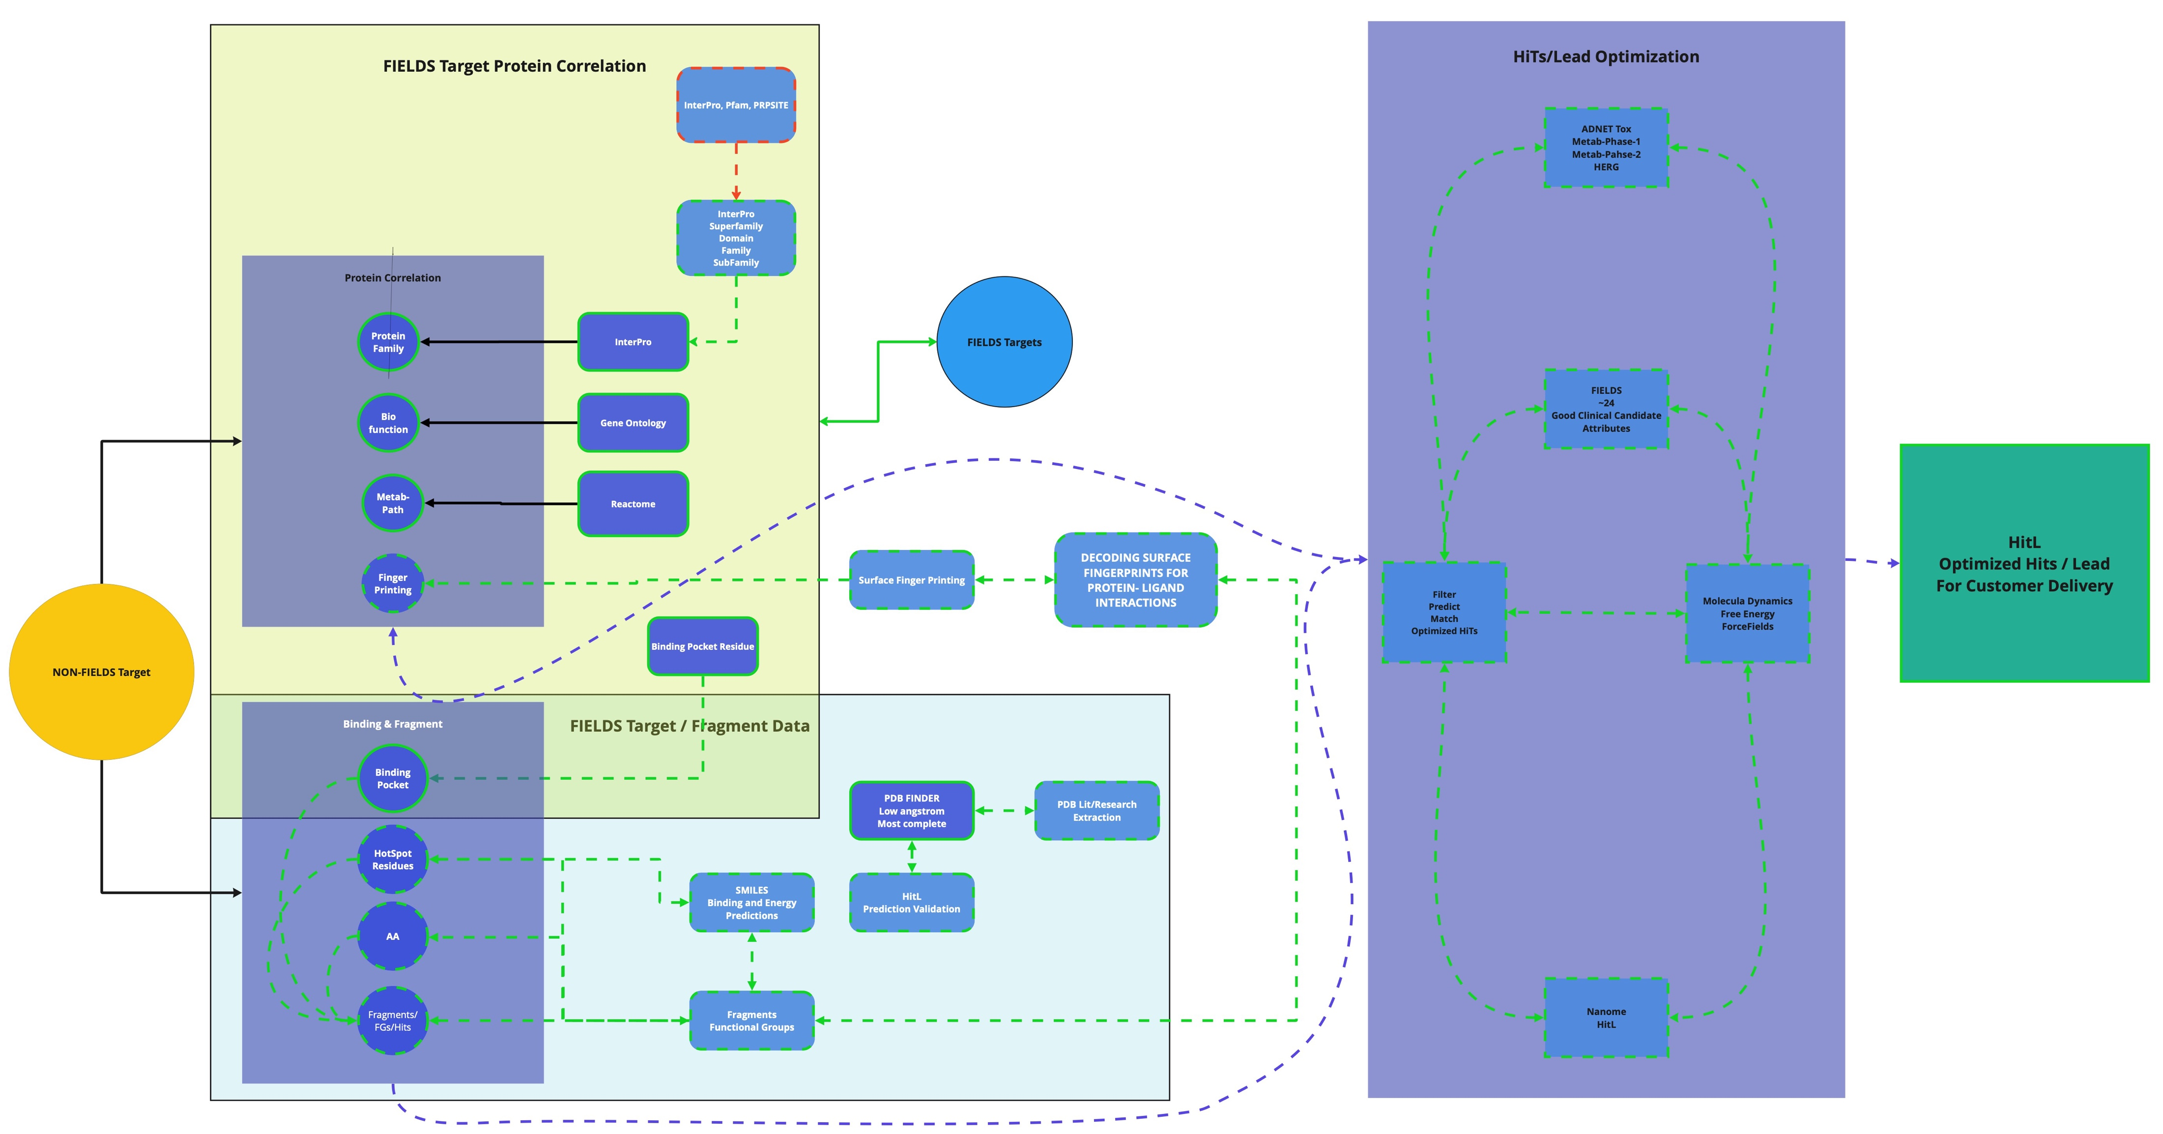
FIELDS™ Process

Slide 10
Objectives
Aggregate Data
Prepare Data
Transform Data
Deploy Data
Automate steps 1-3

Slide 11
Activities and Role
Primary responsibility with creating this tool

Slide 12
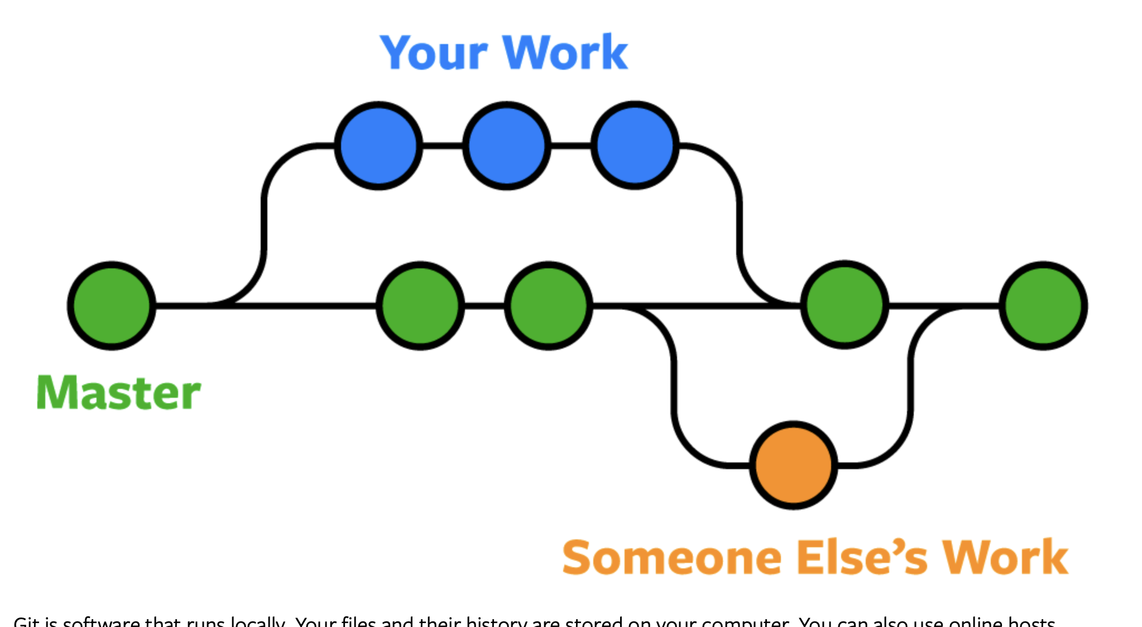
Skills & Knowledge
Git
Notes:
Git
Version control system
Important for code management
Especially when working with a team in non-linear development

Slide 13
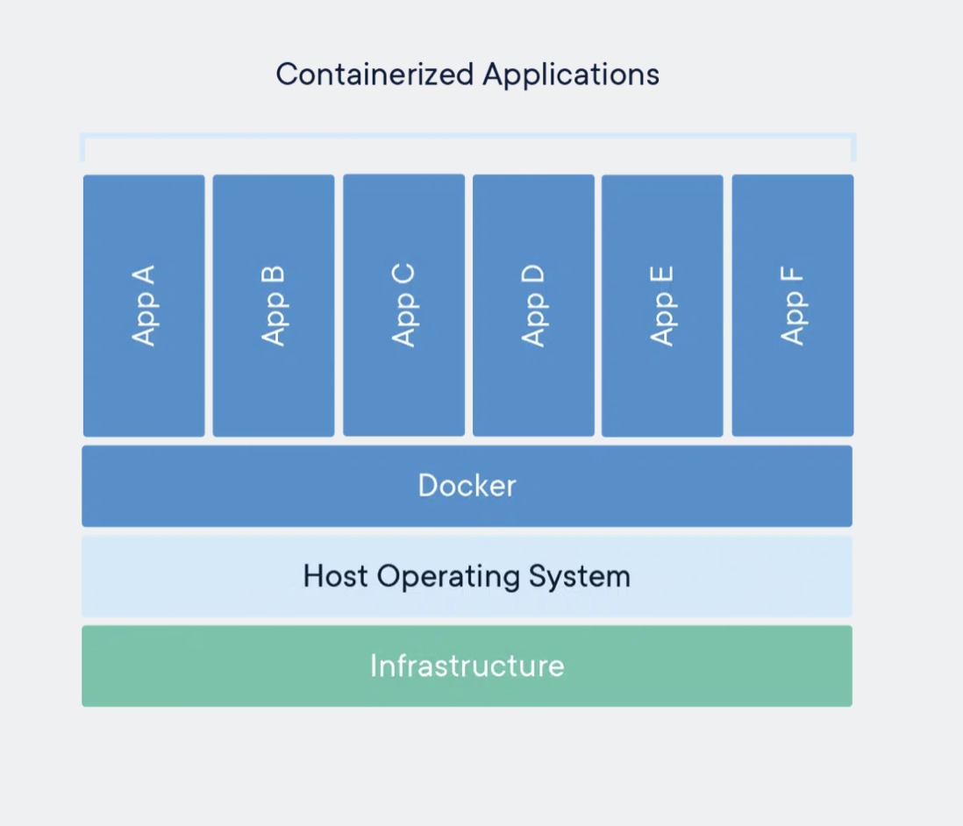
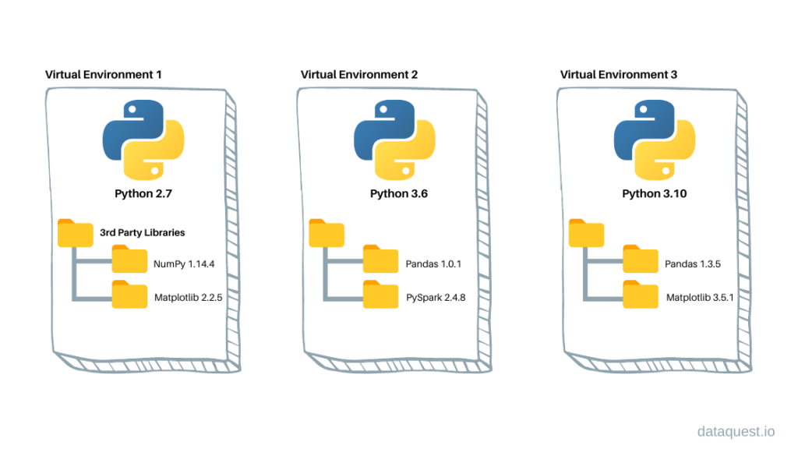
Skills & Knowledge
Virtual Environments
Docker
Notes:
Virtual Environments
Important for keep isolated set of dependencies for projects
Docker
Isolates entire operating system
conveniently create and deploy apps
Scalable
Portable

Slide 14
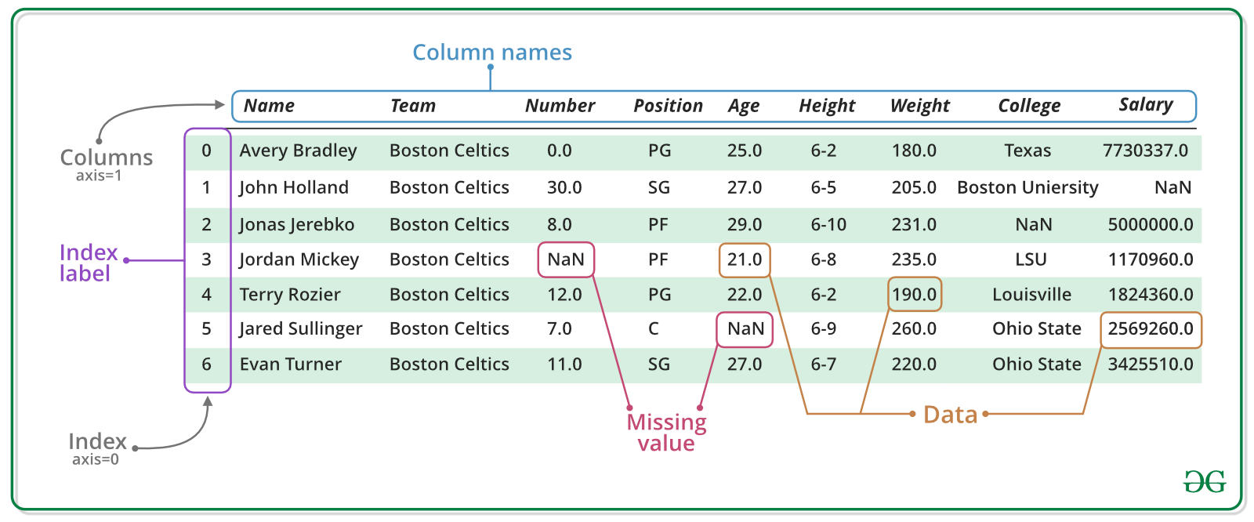
Skills & Knowledge
Polars
Notes:
Polars
Lighter weight pandas (no index)
Pyarrow foundation
Columnar format

Slide 15
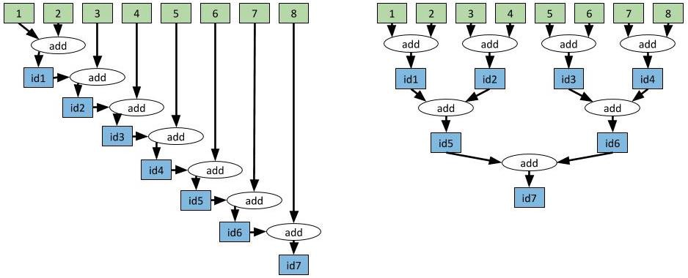
Skills & Knowledge
Ray & Anyscale
Notes:
Ray
Open source project for parallel and distributed Python and scalable computing
Executed in sequence
Anyscale
Provides ray as a service
BIG thing is cluster management
Operates clusters of machines on demand
Scheduling
Optimizes cloud costs with auto scaling and auto suspend
Create unified environment with cluster configurations and dependencies
Flexible dependency management
Base images
Bring your own docker

Slide 16
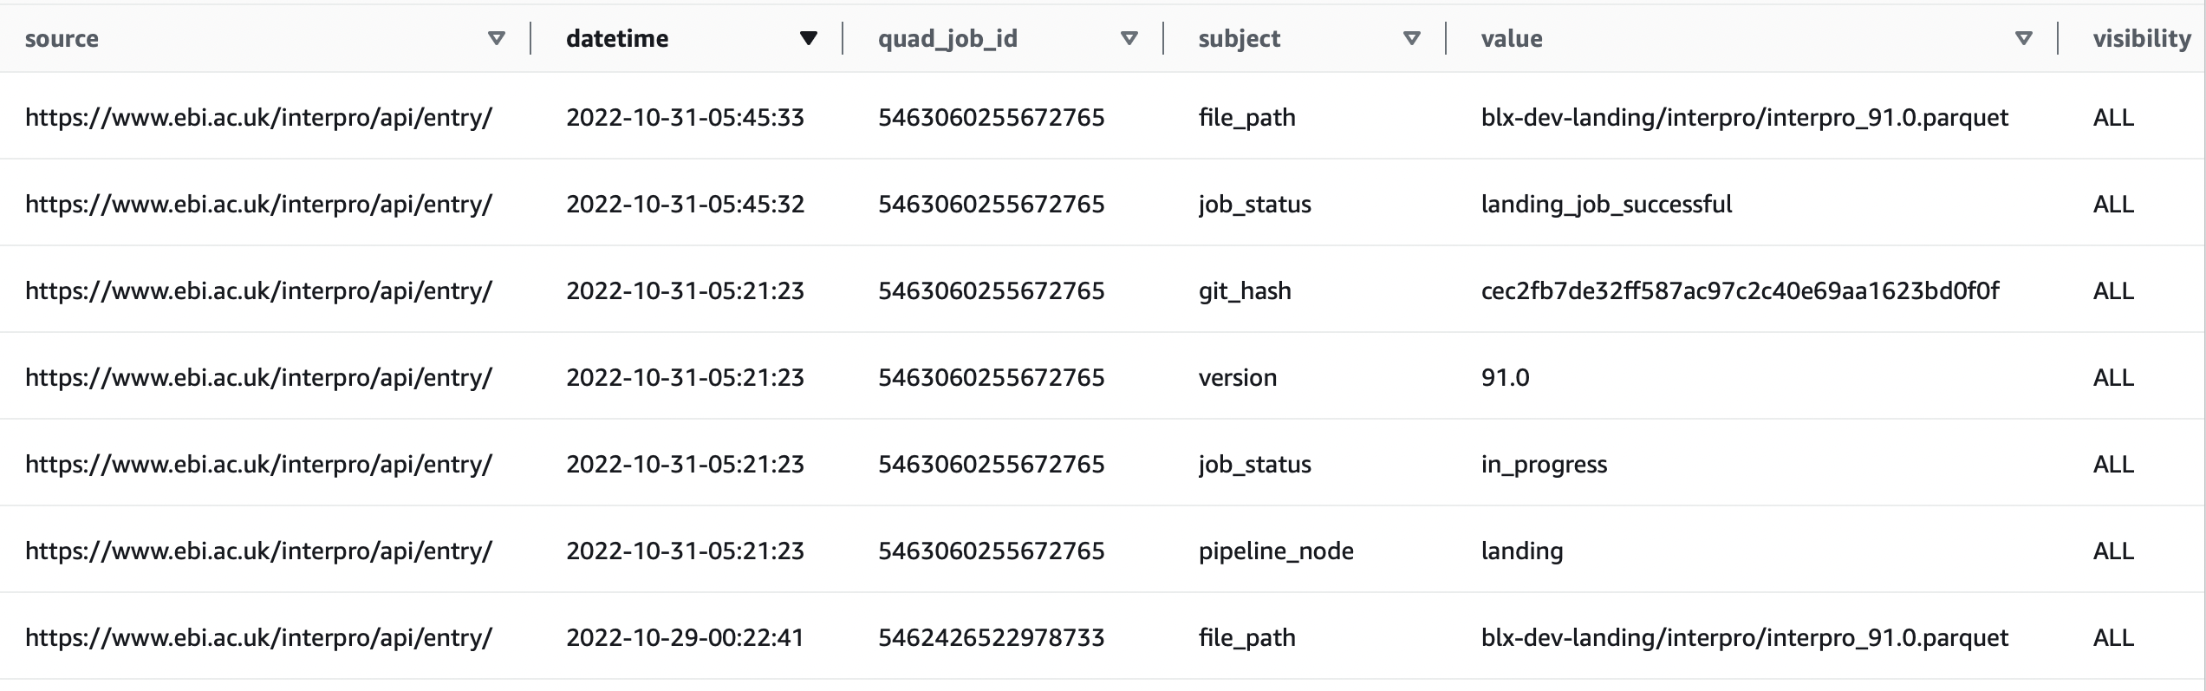
Skills & Knowledge
Amazon Web Services (AWS)
S3
DynamoDB
Notes:
AWS
Cloud computing platform create by amazon
S3
Amazon Simple Storage Service
Object storage service
store and protect any amount of data
DynamoDB
Serverless key-value NoSQL database

Slide 17
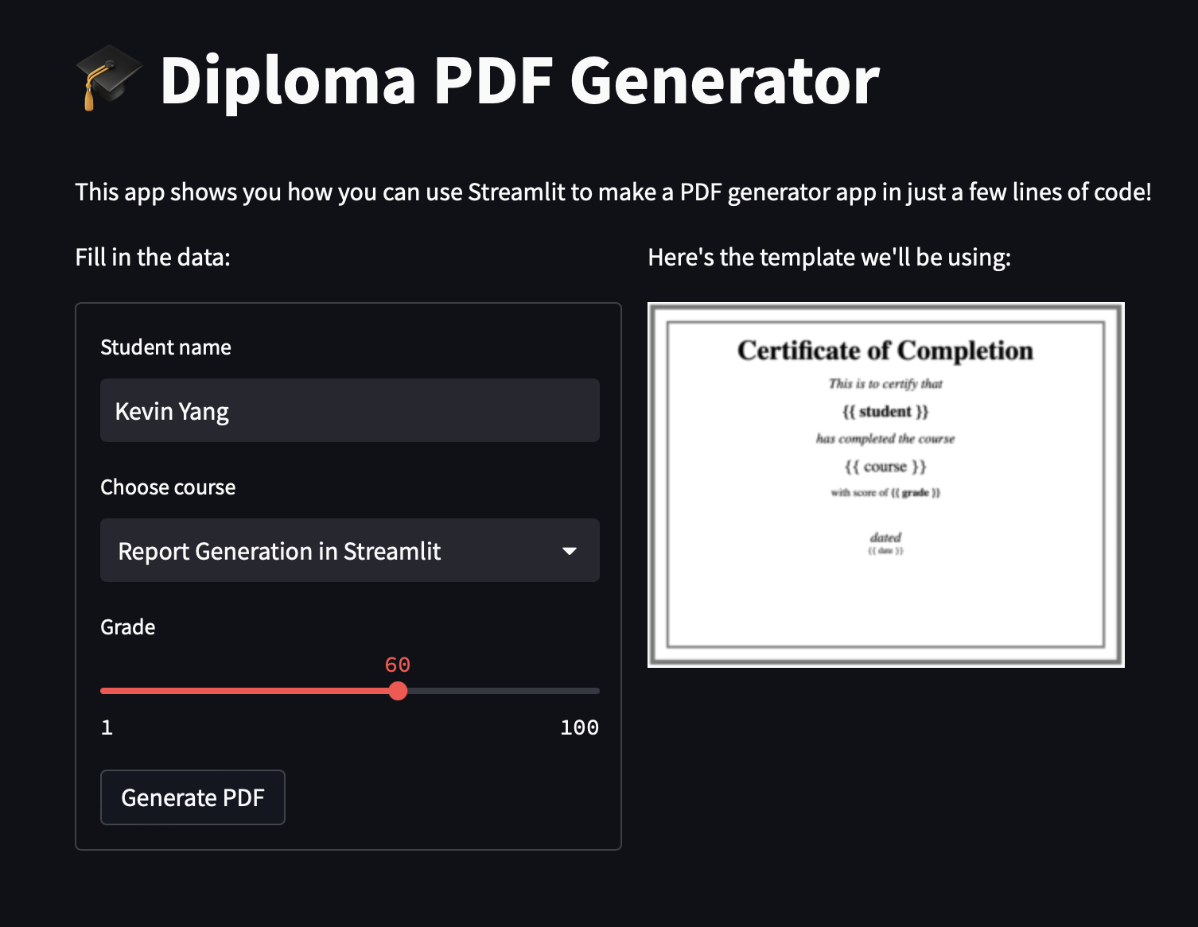
Skills & Knowledge
Streamlit
Notes:
Streamlit
framework for developing and deploying interactive data science dashboards

Slide 18
Data Architecture
Apps (Streamlit)
Outputs
Data Hub
Published
Correlation Score
Management Layer
Core
Binding Pocket
Protein Family
Gene Ontology
Metabolic Pathways
Diseases
Landing
UniProt
InterPro
Gene Ontology
Reactome
Open Targets
Ingest Layer

Slide 19
Landing
Landing
UniProt
InterPro
Gene Ontology
Reactome
Open Targets
Unstructured
Copy of raw data from external databases
Notes:
Uniprot
Database of protein sequence and functional information
primary key and source of our binding pocket sequencing data
Interpro
database of protein families, protein domains, and functional sites where identifiable features can be applied to new protein sequences in order to functionally characterize them
Intention of interpro is to be a one stop shop for protein classification
13 member databases
Clustering algorithm
Manual annotation of bacterial, archaeal and plastid-encoded protein families
Protein disorder annotations
Gene ontology
Ontology is a formal representation of knowledge a domain
Set of classes with relations
3 branches
Molecular Function
Low-level processes
Molecular-level activities performed by gene product
Catalysis
Transport
Cellular Component
Cellular anatomy
Mitochondria
Ribosome
Locations relative to cellular structures where gene product functions
Biological Process
High-level processes
“biological programs” carried out by molecular functions
DNA repair
Signal transduction
SHOULD NOT BE CONFUSED WITH METABOLIC PATHWAY
Reactome
Manually created, peer-reviewed metabolic pathway database
Curation process very similar to editing of a scientific review
An external domain expert provides his or her expertise
Curator formalizes it into the database structure
External domain expert reviews the representation
A system of evidence tracking ensures that all assertions are backed up by the primary literature.
Opentargets (not integrated with target-binding pocket selection)
integrates public data relevant to the association between targets and diseases
integrate data from
genetics,
somatic mutations,
expression analysis,
drugs,
animal models
literature

Slide 20
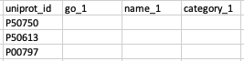
Core
Core
Binding Pocket
Protein Family
Gene Ontology
Metabolic Pathways
Diseases
Standardized Data
Reusable

Slide 21
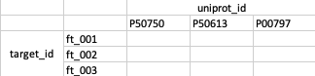
Published
Published
Correlation Score
Processed data for task
Set Similarity Search
Notes:
SetSimilaritySearch
Python package to measure similarity between two sets with jaccard similarity on the IDs
Fractional score between 0 and 1
Intersection size divided by union
Weighted average

Slide 22
Deployed
Apps (Streamlit)
Outputs
Final configuration to be queried, sorted, and displayed

Slide 23
Data Architecture
Apps (Streamlit)
Outputs
Data Hub
Published
Correlation Score
Management Layer
Core
Binding Pocket
Protein Family
Gene Ontology
Metabolic Pathways
Diseases
Landing
UniProt
InterPro
Gene Ontology
Reactome
Open Targets
Ingest Layer

Slide 24
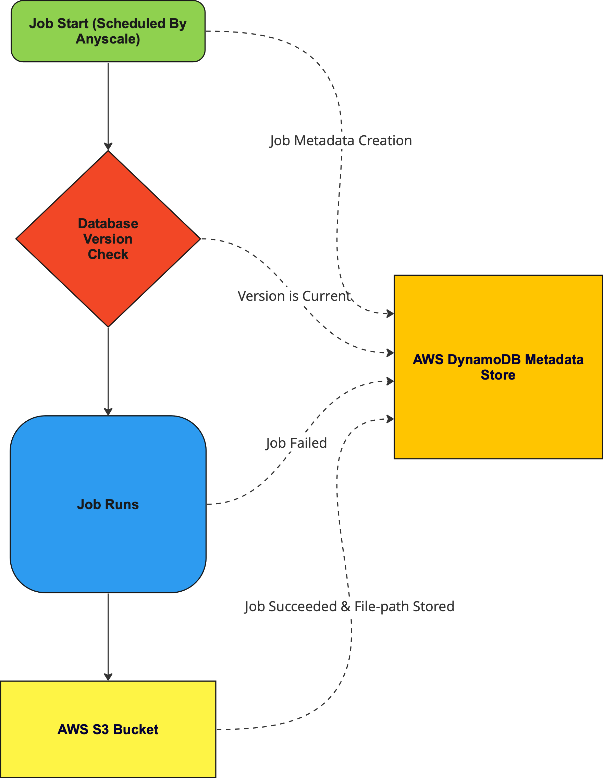
System Design
Notes:
Job run
Ingestion
Manipultion and/or selection
AWS S3 Bucket
2 copies
One with name and version
One overwrites _latest
Metadata contents:
Git commit hash
External version checked
Pipeline node
Landing
Transform
Publish

Slide 25
Lessons Learned
More than just being able to use the tools
Communication > technique
Always more to learn
Would’ve like to work with team in person
More deliberate project planning

Slide 26
Relevance to Informatics
Protein are an incredibly complex and crucial macromolecule in biological life (3)
116,000 / 61,000,000 protein sequences have known 3D structures (2016) (2)
Understanding structure and folding gives scientists' insights on human disease and how to design drugs to target protein (1)
Notes:
Crucial to understand folding and 3D structure because it gives scientists great insight to protein function

Slide 27
Thank You Biolexis Team!
Dave Bearss, Ph.D.
Hari Vankayalapati, M.Pharm. Ph.D.
David Taylor, MBA
Kyle Medley, M.S. MBA
Jake Carter
Nik Jenson
Evan Marshman
Cameron Zabriskie
Zhaoliang Li, Ph. D.
Micah Harman
Andrea Groen

Slide 28
Sources
https://www.ncbi.nlm.nih.gov/pmc/articles/PMC6829626/
https://www.ncbi.nlm.nih.gov/pmc/articles/PMC2686606/
https://pubmed.ncbi.nlm.nih.gov/4368490/
Notes:
Crucial to understand folding and 3D structure because it gives scientists great insight to protein function

Slide 29
Showcase

